Slide 1

Computational Concepts in Ancient India
By
Yashwanth S

Slide 2
The Vedic Roots of Mathematics: Seeds of Computation
Numerical Systems
Geometric Concepts
Computational Procedures
Vedic texts contain early numerical systems. These texts laid the foundation for later mathematical developments.
Vedic rituals involved precise geometric constructions. These constructions demonstrate early geometric understanding.
Vedic scholars developed computational procedures. They needed these procedures for astronomy and calendar-making.

Slide 3

The Decimal System and Zero: Indian Numeral System Revolution
Decimal System
Concept of Zero
India invented the decimal system. It uses ten symbols to represent numbers.
The concept of zero originated in India. Zero is both a number and a placeholder.
Positional Notation
Positional notation enhances number representation. It assigns value based on position.

Slide 4

Panini's Grammar: The Dawn of Formal Language Theory
1
Astadhyayi
Panini's Astadhyayi is a Sanskrit grammar. It contains 4,000 rules.
2
Formal Rules
Panini used formal rules to describe Sanskrit. These rules are similar to modern formal languages.
3
Linguistic Analysis
His work influenced linguistic analysis and computation. It is a foundation for computer science.

Slide 5




Katapayadi System: Ancient Indian Cryptography
Numeral Encoding
The Katapayadi system encodes numerals using letters. It uses consonants to represent numbers.
Mnemonics
It helps in creating mnemonic verses. These verses represent numerical data.
Cryptography
Katapayadi is an early form of cryptography. It hides numerical information.

Slide 6



Jain Mathematics: Infinity and Combinatorics
Combinatorics
2
Jain texts contain early combinatorics. They analyzed permutations and combinations.
Theory of Infinity
1
Jain mathematics explores infinity. They conceptualized different levels of infinity.
Number Theory
They also contributed to number theory. This included classifications of numbers.
3

Slide 7




Kerala School of Astronomy and Mathematics: Precursors to Calculus?
Trigonometric Series
Infinite Series
Calculus Concepts
The Kerala school developed trigonometric series. They used it for astronomical calculations.
They explored infinite series expansions. This included sine and cosine functions.
Some see their work as precursors to calculus. Their concepts influenced later European mathematics.

Slide 8
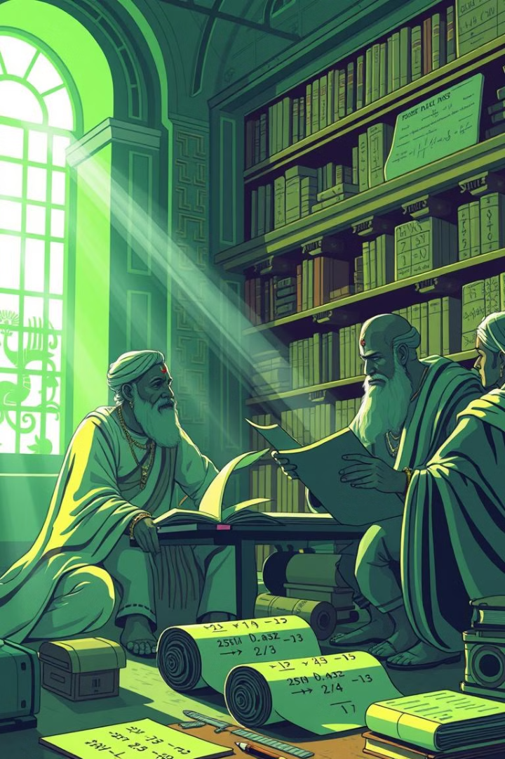
Indian Influence on Global Mathematics and Computation
1
Numeral Adoption
2
Mathematical Influence
The decimal system spread globally. Arabic scholars then transmitted this system.
Indian mathematics influenced European scholars. This fueled Renaissance mathematics and science.
3
Computational Legacy
India's contributions shaped modern computation. This includes algorithms and formal language theory.

Slide 9
Critiques and Considerations: Reevaluating Historical Narratives
Eurocentric Bias
Source Scarcity
Interdisciplinary Research
Some narratives overlook Indian contributions. They attribute advancements solely to Europe.
Limited historical sources present challenges. It makes comprehensive analysis difficult.
New research reevaluates India's role. It combines history, mathematics, and linguistics.

Slide 10
Modern Relevance: Lessons from Ancient Indian Computational Thinking
1
Algorithm Design
2
Formal Systems
3
Abstract Thinking
India's rich heritage inspires innovation. Abstract thinking is a key capability. Formal systems and algorithm designs are critical too.

Slide 11
Thank You!

